Slide 1

Exploratory Data analysis Of Housing Data
PRESENTED BY: JEEVANANTHAM.R
DATE:26/07/2025
COURSE:DATA ANALYST AND DATA SCIENTIST
BATCH:RP-36,MAY BATCH

Slide 2
Introduction
Data understanding
Data cleaning
AGENDA
EDA and Data Visualization
Feature Engeneering
Insights
Conclusion

Slide 3
The Housing dataset serves as a comprehensive source for analyzing residential property trends and market dynamics.
It has the key attributes such as prices, number of bedrooms and bathrooms, location, square footage, lot size and the year of construction.
INTRODUCTION
Explore the structure and features of the dataset.
Identify missing values and apply appropriate data cleaning strategies.
Perform Exploratory Data Analysis(EDA) to reveal insightful trends.
Apply statistical techniques to support hypothesis and predicitions.

Slide 4
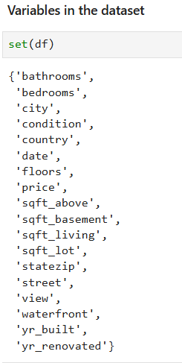
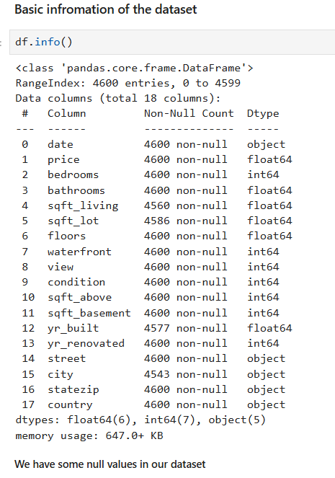
First we have to understand our data for processing.
Then we have to find the key columns for our analysis.
Then we have to find the basic information of the dataset like info, shape, data types.
Here the dataset has 4600 rows and 18 columns.
Datatypes: datetime, categorical and numerical.
DATA UNDERSTANDING

Slide 5
Handling Missing Values
Remove Duplicates
DATA CLEANING
Fix Data Types
Outlier Detection and Treatment
Data Transformation
Validation and Final Checks

Slide 6


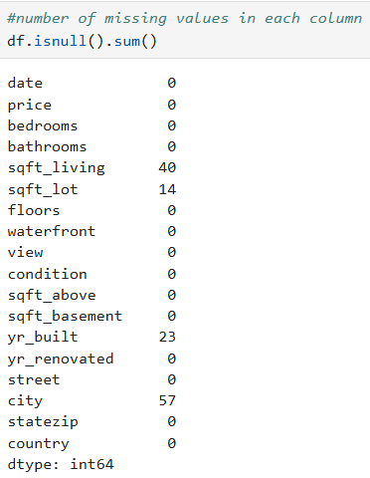
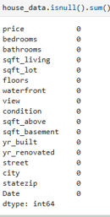
First we have to find the null values.
Numerical columns filled with mean or median.
Categorical columns filled with mode.
Drop the columns with 50% of missing values or null values.
HANDLING MISSING
VALUES
Before removing null values:
After removing null values:

Slide 7
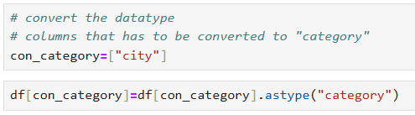
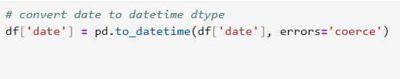
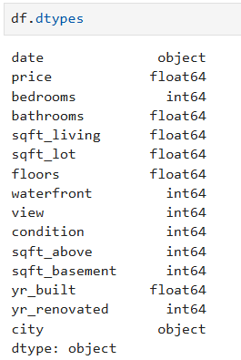
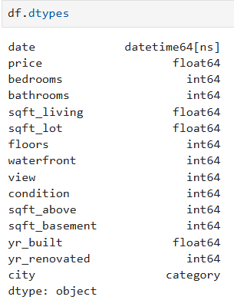
We have fix the data types for the columns.
If price column is in object type we have to change it to the float or integer type according to the data.
FIXING DATA TYPES
Before :
After:

Slide 8
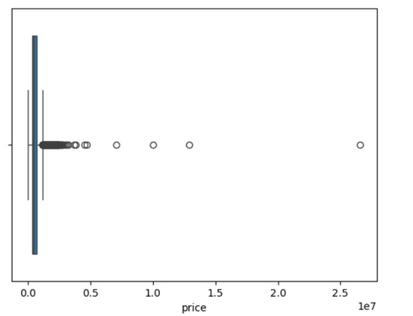
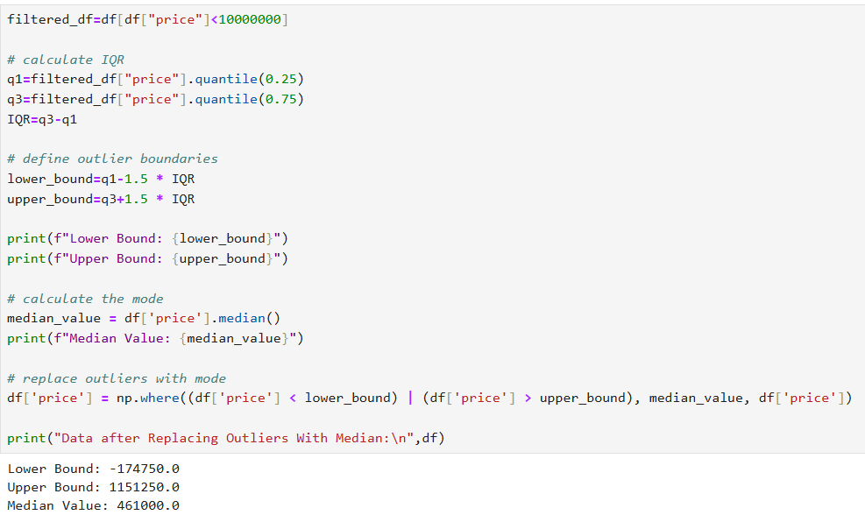
An outlier is a data point that stands out dramatically form the rest of a dataset.
It is either much higher or much lower than the other values.
OUTLIER DETECTTION AND TREATMENT

Slide 9
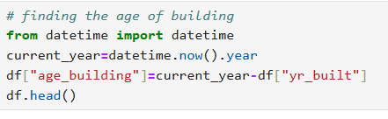

It refers to the process of converting, cleaning or modifying data to make it suitable for analysis or other operations.
It’s like preparing ingredients before cooking-you reshape raw data into a format that’s more digestible, meaningful and usable.
Makes dataset cleaner and more consistent.
DATA TRANSFORMATION

Slide 10
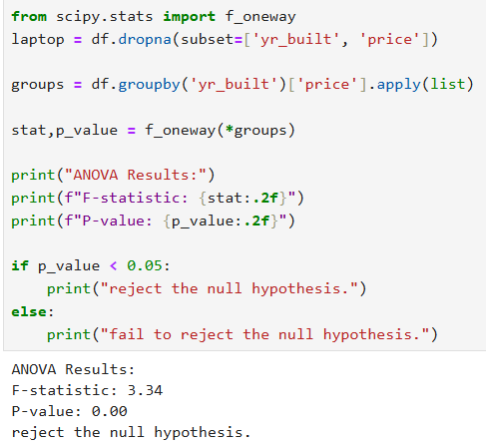
Anova Test:
STATISTICAL ANALYSIS

Slide 11
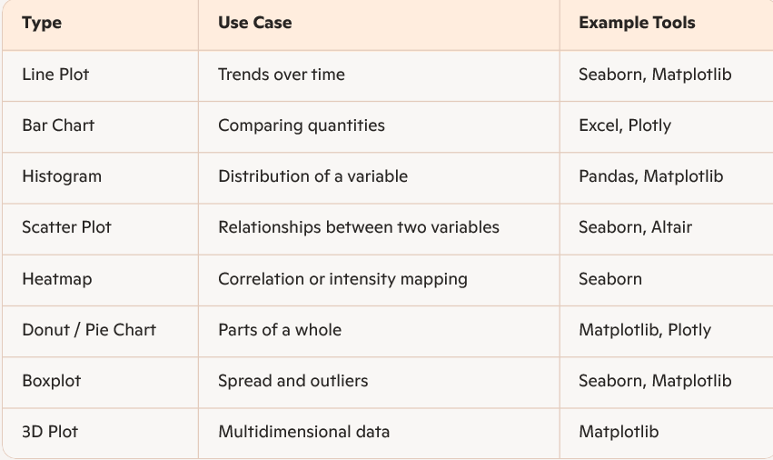
It is the art and science of turning raw data into visual formats.
Simplifies complex data : Helps to make sense of huge datasets quickly.
Supports decisions : Easier to spot opportunities or issues and act accordingly.
DATA VISUALIZATION

Slide 12
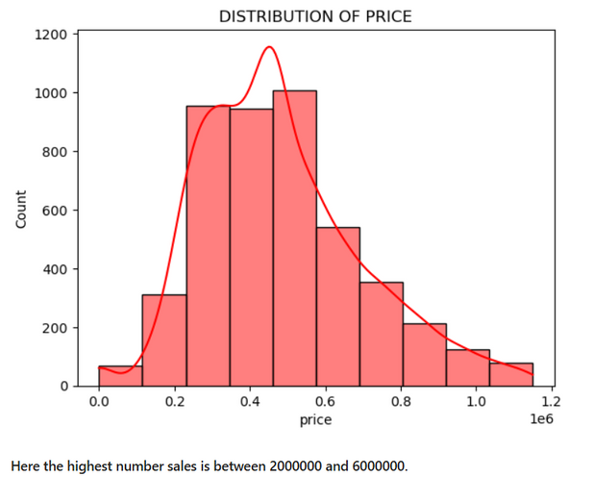
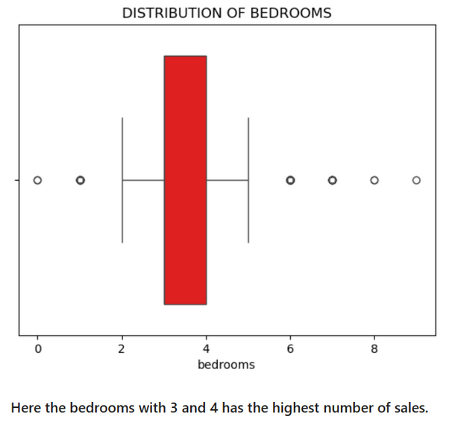
It is a type of data analysis that looks at just one variable at a time.
UNIVARIATE ANALYSIS

Slide 13
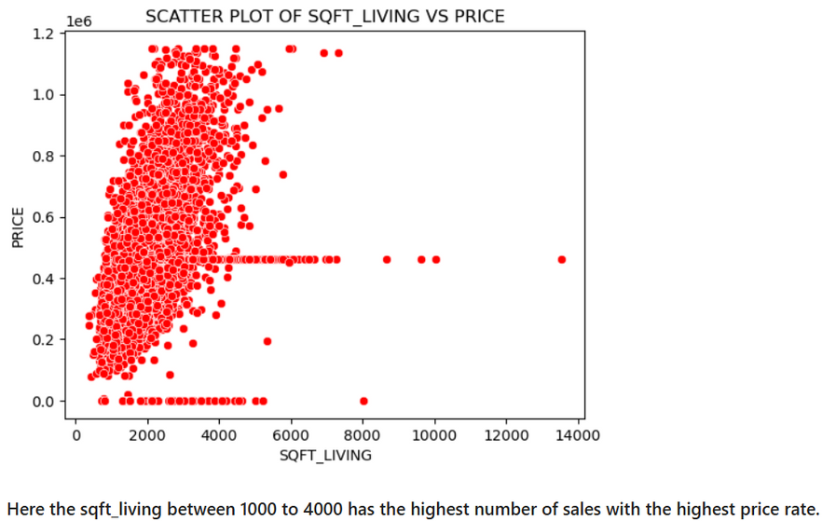
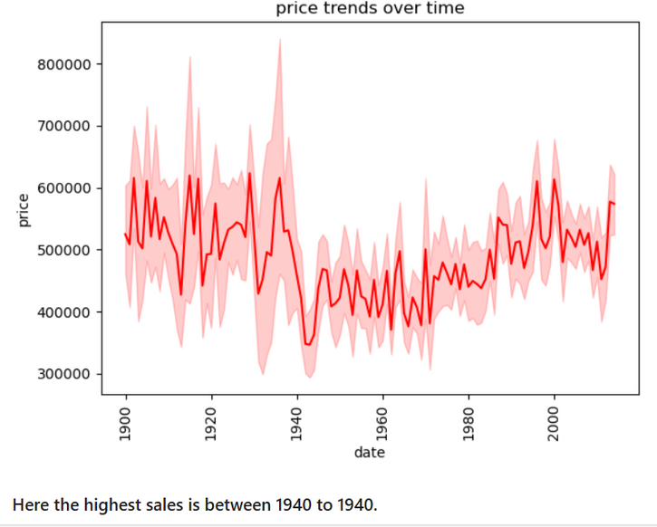
It is all about exploring the relationship between two variables.
BIVARIATE ANALYSIS

Slide 14
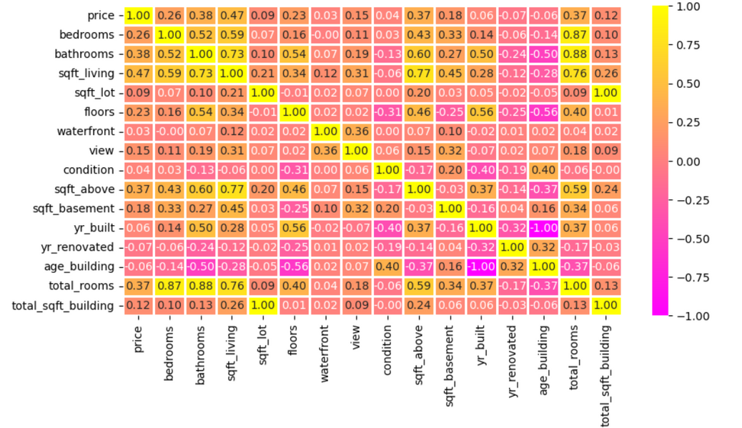
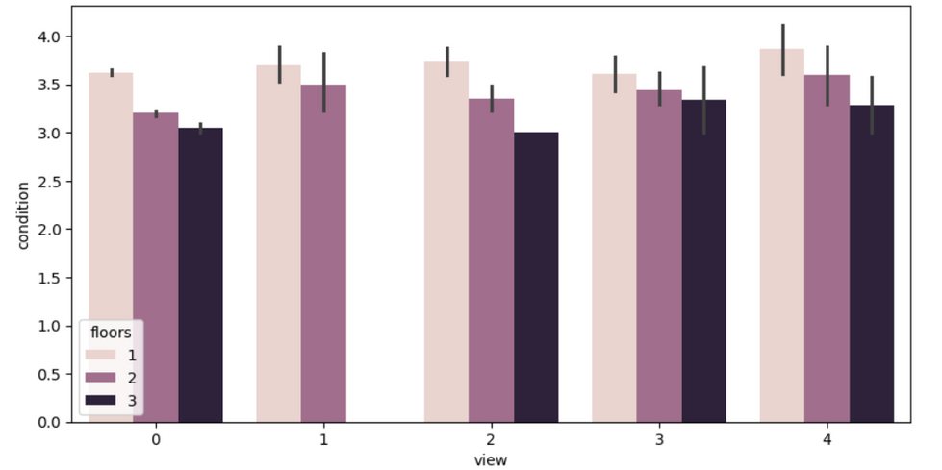
It involves more than two variables for observation. Predict outcomes based on multiple factors.
MULTIVARIATE ANALYSIS

Slide 15
Total square area of the building is strongly connected with the price. since, the larger square area has the demand of higher sales price.
The bedrooms with 3 and 4 has the highest rate of sales.
The bathrooms with 2 and 3 has the highest rate of sales.
More customers have the potential to buy the total number of rooms with 6.
The condition with 4 and 5 has the highest number of sales.
INSIGHTS
The views with 3 and 4 has the highest number of sales.
The customers are preferring newly built house.
The customer also preferring the renovated buildings.
Most buildings are mid-aged(20-40 years)
The price is right-skewed due the luxury buildings.
The average price of the building is between 4000000 and 6000000.
The SEATTLE city has the highest number of sales.

Slide 16
This housing data shows that value of the property is impacted by the location of the building, total square area of the building, condition of the building, renovation of the building, total rooms of the building.
By detailed data exploration and statistical tests we find the clear patterns and trends over the time and the factors and the price trends.
CONCLUSION
This analysis gives the detailed insights for the buyers,sellers and investors who want to make a decision to purchase or selling the property.
This analysis is helpful for the real estate persons to make a decision.

Slide 17
THANK YOU!

